Slide 1
Introduction To DataBases
Represented by rzouga

Slide 2
What is relational database
A relational database includes tables containing rows and columns. For example, a typical business order entry database would include a table that describes a customer with columns for name, address, phone number and so forth.

Slide 3
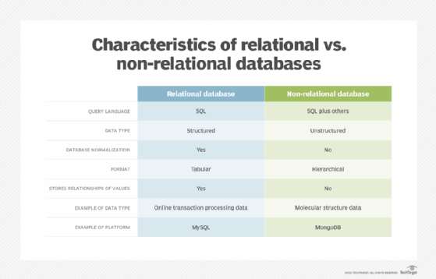

Slide 4
MySQL
MYSQL is a database management system,
MYSQL databases are relational:
-The SQL part of « MYSQL »stands for « structered query language ».
-It is the most common standardized language used to access databases.
MYSQL database is very fast ,reliable,scalable,and easy to use.
MYSQL server works in client/server or embedded systems.

Slide 5
SQL Server
Microsoft SQL Server is a database management system (DBMS) in SQL language incorporating, among other things, a RDBMS (relational DBMS) developed and marketed by Microsoft. It works on Windows and Linux OS (since March 2016), but it is possible to launch it on Mac OS via Docker, as there is a version available for download on the Microsoft2 site.

Slide 6
PostgreSQL
PostgreSQL is a relational and object-oriented database management system (RDBMS). It is a free tool available under the terms of a BSD-style license. This system is comparable to other database management systems, whether free (like MariaDB and Firebird), or proprietary (like Oracle, MySQL, Sybase, DB2, Informix, and Microsoft SQL Server). Like the free Apache and Linux projects, PostgreSQL is not controlled by a single company, but is founded on a global community of developers and companies.

Slide 7
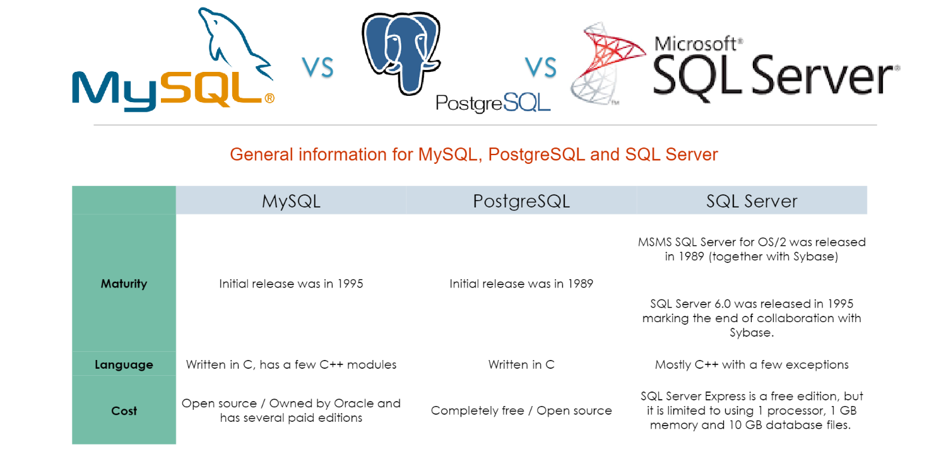
Difference Between MYSQL And PostgreSQL And SQL server

